Slide 1

CH 42010: PROCESS PLANT OPERATION & SAFETY
LTP: 3-0-0, CRD: 3
Lecture 2
Procedure for Systematic Study of Plants

Slide 2
SYSTEMATIC PLANT STUDY METHODS
Process Flow Analysis
Objective: To understand the entire process flow within a plant, from raw materials to finished products.
Methodology: Map out each stage of the process using process flow diagrams (PFDs) and piping and instrumentation diagrams (P&IDs) to identify inefficiencies, bottlenecks, and areas for optimization.
Tools: Process flowcharts, PFDs, P&IDs.
Failure Modes and Effects Analysis (FMEA)
Objective: To identify and prioritize potential failure modes and assess their impact on the plant.
Methodology: For each piece of equipment or process, list possible failure modes, assess their likelihood and impact, and assign a risk priority number (RPN) to guide maintenance and corrective actions.
Tools: FMEA worksheets, risk assessment tables.
Hazard and Operability Study (HAZOP)
Objective: To identify safety and operability issues within the plant processes.
Methodology: A team systematically reviews each segment of the process, asking "What if?" questions to determine how deviations from normal operating conditions could lead to hazards.
Tools: HAZOP worksheets, checklists, brainstorming sessions.

Slide 3
SYSTEMATIC PLANT STUDY METHODS
Root Cause Analysis (RCA)
Objective: To determine the underlying causes of a failure or undesirable event.
Methodology: After an incident, investigate and trace back each contributing factor to uncover the primary cause, allowing for effective corrective actions.
Tools: Fishbone diagrams, the 5 Whys, fault tree analysis.
Reliability-Centered Maintenance (RCM)
Objective: To improve plant reliability by determining the best maintenance approach for each piece of equipment.
Methodology: Evaluate equipment based on its function, failure modes, and effects of failure to decide on preventive, predictive, or corrective maintenance.
Tools: RCM worksheets, criticality analysis, maintenance records.
Relevant to Chemical Process Calculations Course also
Energy and Material Balances (EMB)
Objective: To analyze the plant’s energy and material usage and identify inefficiencies or losses.
Methodology: Track inputs and outputs of energy and materials across each unit operation to pinpoint waste, improve energy efficiency, and reduce costs.
Tools: Mass and energy balance equations, flow meters, monitoring software.

Slide 4
SYSTEMATIC PLANT STUDY METHODS
Statistical Process Control (SPC)
Objective: To monitor and control plant processes through statistical analysis.
Methodology: Collect data from critical control points and use statistical techniques to identify trends, deviations, and opportunities for improvement.
Tools: Control charts, histograms, trend analysis.
Key Performance Indicator (KPI) Analysis
Objective: To measure plant performance against specific benchmarks to track operational efficiency, productivity.
Methodology: Define relevant KPIs such as throughput, downtime, energy usage, and yield, and regularly track these indicators to identify improvement areas.
Tools: KPI dashboards, benchmarking reports.
Life Cycle Assessment (LCA)
Objective: To evaluate the environmental impact of plant processes and products throughout their life cycle.
Methodology: Assess the environmental impacts of materials, energy, emissions, and waste from raw material extraction to disposal, aiming to minimize negative environmental effects.
Tools: LCA software, environmental impact assessment tables.
22-01-2025
4

Slide 5
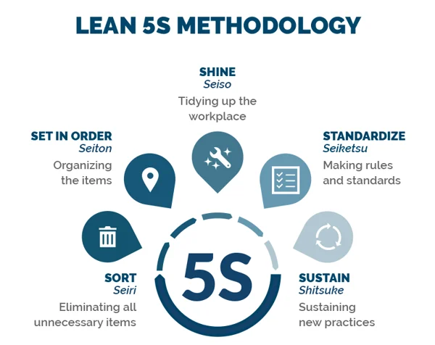

SYSTEMATIC PLANT STUDY METHODS
Lean Manufacturing Techniques
Objective: To streamline operations by eliminating waste and improving efficiency.
Methodology: Implement principles like the 5S method, value stream mapping, and Kaizen to reduce waste in time, materials, and processes.
Tools: Value stream maps, 5S checklists, Kaizen improvement sheets.
Six Sigma Analysis (6σA)
Objective: To improve quality by reducing process variability and defect rates.
Methodology: Use the DMAIC (Define, Measure, Analyze, Improve, Control) framework to systematically identify sources of variation and implement solutions.
Tools: Control charts, Pareto analysis, DMAIC worksheets.
Fault Tree Analysis (FTA)
Objective: To analyze and understand potential causes of a specific failure event.
Methodology: Develop a tree-like structure with logical relationships to trace possible causes of a top event, allowing for targeted preventive actions.
Tools: Fault tree diagrams, Boolean logic gates.

Slide 6
SYSTEMATIC PLANT STUDY METHODS
Simulation and Modeling
Objective: To predict how process changes might affect plant performance and identify potential improvements.
Methodology: Create computational models of processes using simulation software to test various scenarios and optimize performance.
Tools: Process simulators (e.g., Aspen HYSYS, MATLAB, COMSOL), flow and thermal models.
Environmental Impact Analysis
Objective: To assess the environmental effects of plant operations, including emissions, waste, and resource use.
Methodology: Conduct an environmental review focused on compliance with regulations and minimizing ecological impacts.
Tools: Emissions monitoring equipment, environmental impact reports, regulatory checklists.
Important Terminologies to Know & Understand
PFD
P&ID
FMEA
HAZOP
RCA
EMB
KPI
FTA
6σA
22-01-2025
6

Slide 7
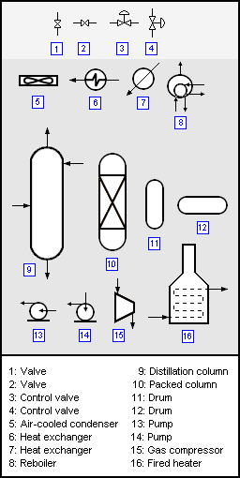
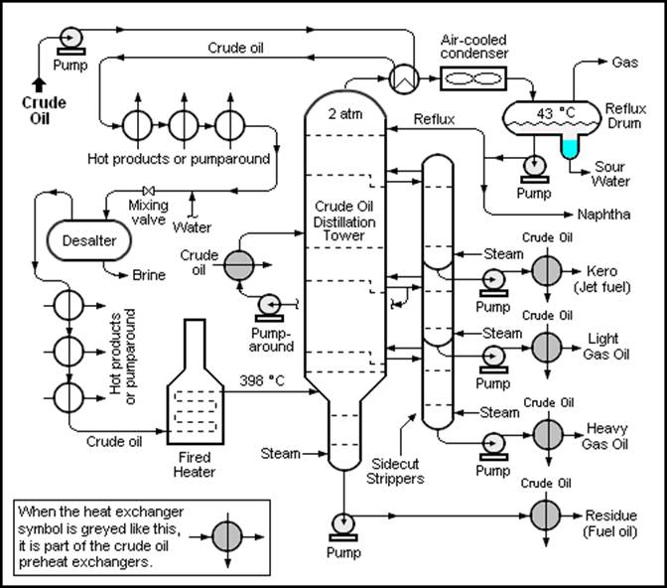
PROCESS FLOW DIAGRAMS (PFD)
Commonly used in chemical and process engineering to indicate the general flow of plant processes and equipment.
Source: Google Images
22-01-2025
7

Slide 8
PROCESS FLOW DIAGRAMS (PFD)
Commonly used in chemical and process engineering to indicate the general flow of plant processes and equipment.
The PFD displays the relationship between major equipment of a plant facility and does not show minor details such as piping details and designations.
Another commonly used term for a PFD is Process Flowsheet.
Process flow diagrams of multiple process units within a large industrial plant will usually contain less detail and may be called block flow diagrams (BFD) or schematic flow diagrams (SFD).
Source: Google Images
22-01-2025
8

Slide 9
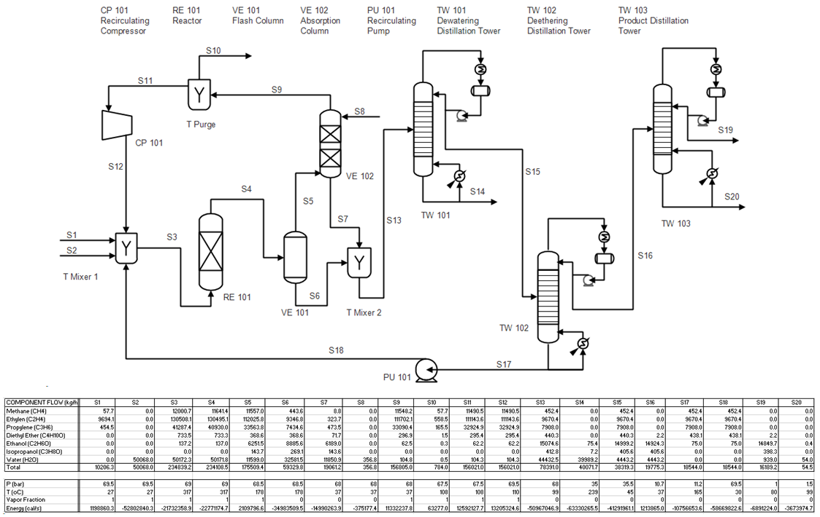
PROCESS FLOW DIAGRAMS (PFD)
PFD shows the arrangement of the major equipment and general flow to carry out the process.
PFD: All major equipments, stream connections, stream flow rates, compositions and operating conditions.
PFD: used for fixing process parameters such as flow, temperature and pressure of the chemical plant during normal operations.
C₂H₅OH
CH₄, C₂H₄, C₃H₆
H₂O
Source: Google Images
PFD: also used for process understanding, process improvement, quality control and process trainings.
22-01-2025
9

Slide 10
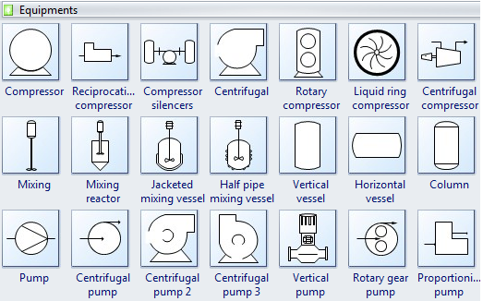
PROCESS FLOW DIAGRAMS (PFD)
Typically, PFD of a single unit process include the following:
Process piping
Major equipment items
Connections with other systems
Major bypass and recirculation (recycle) streams
Operational data (temperature, pressure, etc.)
Process stream names, Mass balance
PFD generally do not include:
Pipe classes or piping line numbers
Instrumentation details
Minor bypass lines
Instrumentation
Controllers like Level Control or Flow Control
Isolation and shutoff valves
Maintenance vents and drains
Relief and safety valves, Flanges
Visualize all the PFD Equipment Symbols
https://www.vistaprojects.com/pfd-symbols/
https://www.edrawsoft.com/pfd-symbols.html
https://www.conceptdraw.com/How-To-Guide/process-flow-diagram-symbols
Source: Google Images
22-01-2025
10

Slide 11
PIPING & INSTRUMENTATION DIAGRAM (P&ID)
P & ID shows the graphical engineering details and arrangement of the equipment, instruments, piping, valves and fittings and other process equipment in a chemical process plant.
P&ID is used by the engineer for laying out a process control installation.
For a process operator it is used for an activity called “line tracing”. A line tracing activity is a type of chemical plant familiarization training by comparing every detail in a P&ID with real equipment, fittings and instrumentation at site.
A P&ID should include:
All process equipment identified by an equipment number with location of nozzles and drawn roughly in proportion.
All pipes identified by a line number with pipe size and material of construction.
All valves, control and block valves, with an identification number with size and types (differentiate by symbols)
Ancillary fittings that are part of the piping system, such as inline sight glasses, strainers and stream traps; with an identification number.
Pumps, identified by a suitable code number.
All control loops and instrument, with an identification number.
22-01-2025
11

Slide 12
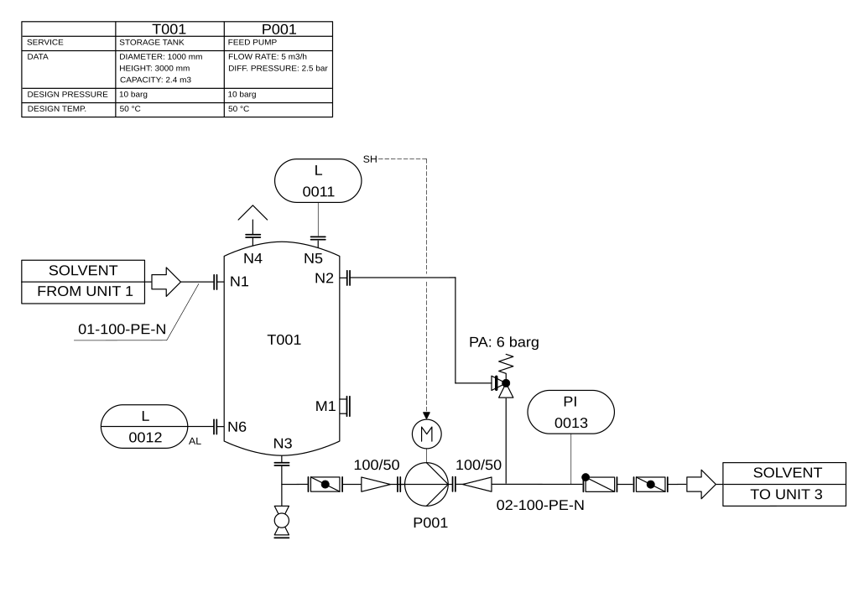
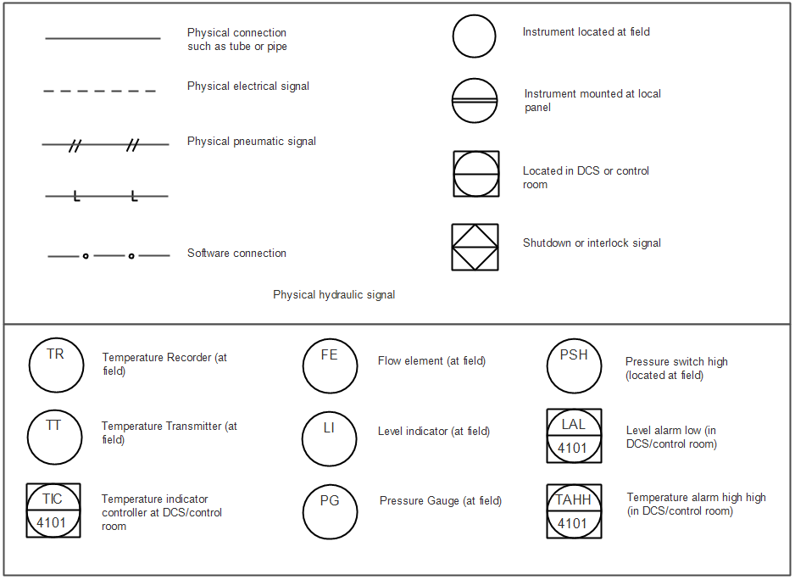
PIPING & INSTRUMENTATION DIAGRAM (P&ID)
P&ID of pump with storage tank
Examples of P&ID Symbols
Source: Google Images
Symbols according to EN ISO 10628 and EN 62424
22-01-2025
12

Slide 13
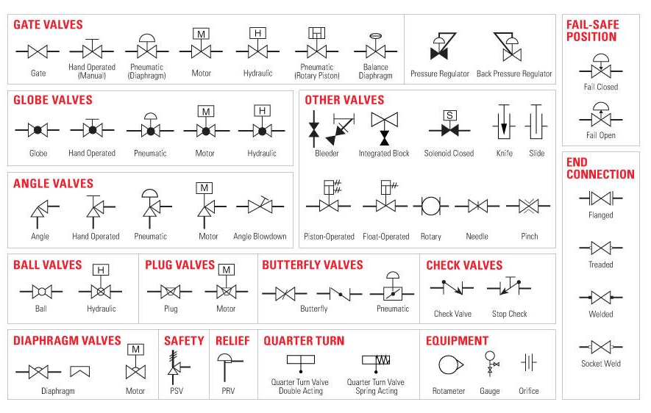
PIPING & INSTRUMENTATION DIAGRAM (P&ID)
Some more examples of P&ID Symbols
Visualize all the P&ID Symbols
https://www.vistaprojects.com/common-pid-symbols/
https://www.edrawsoft.com/pid/images/pid-legend.pdf
Source: Google Images

Slide 14
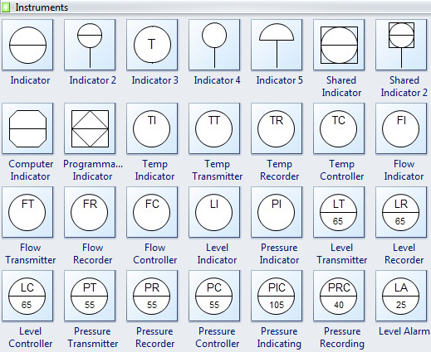
PIPING & INSTRUMENTATION DIAGRAM (P&ID)
Some more examples of P&ID Symbols
Visualize all the P&ID Symbols
https://www.vistaprojects.com/common-pid-symbols/
https://www.edrawsoft.com/pid/images/pid-legend.pdf
Source: Google Images

Slide 15
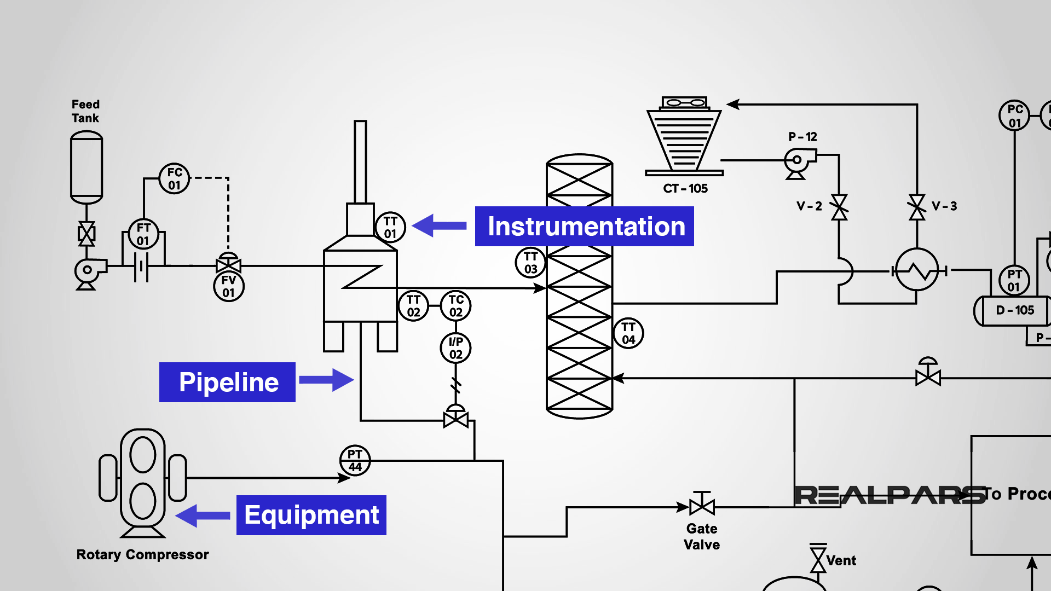
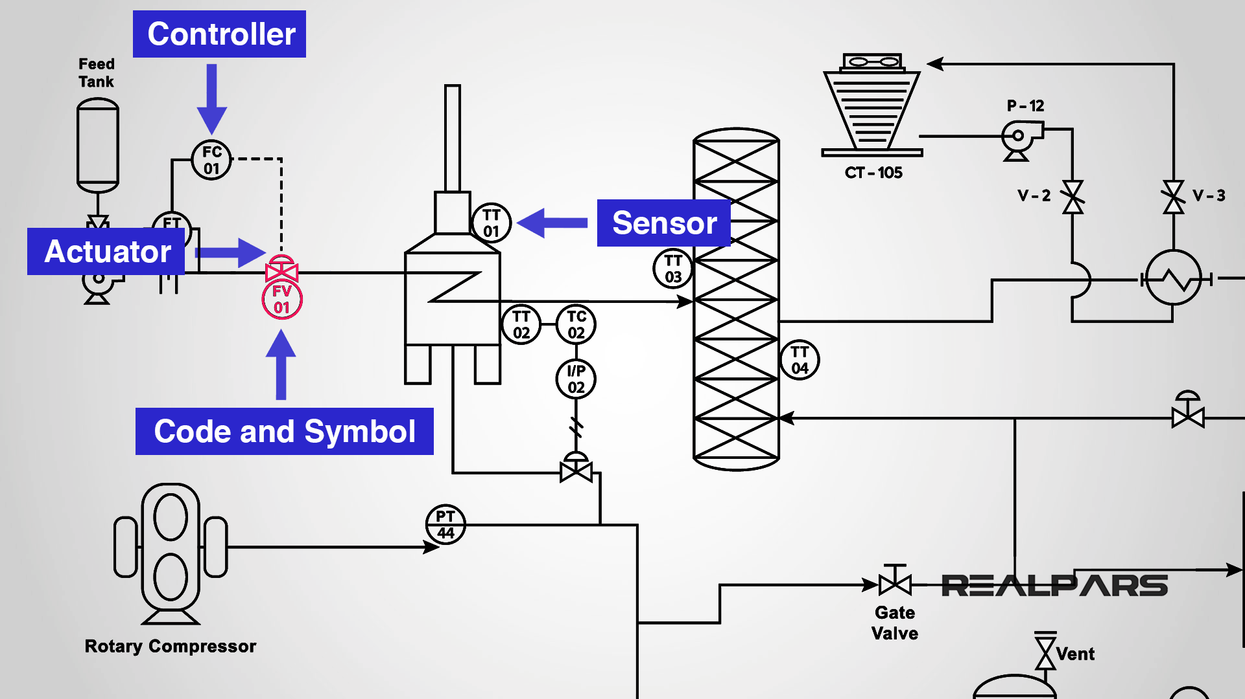
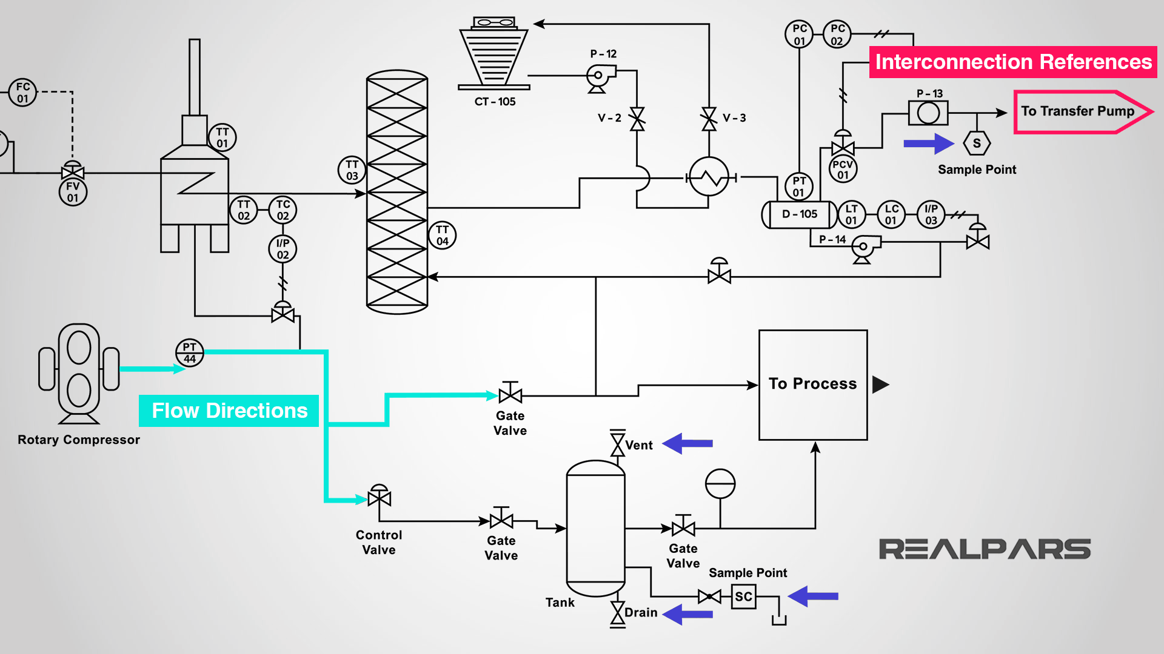
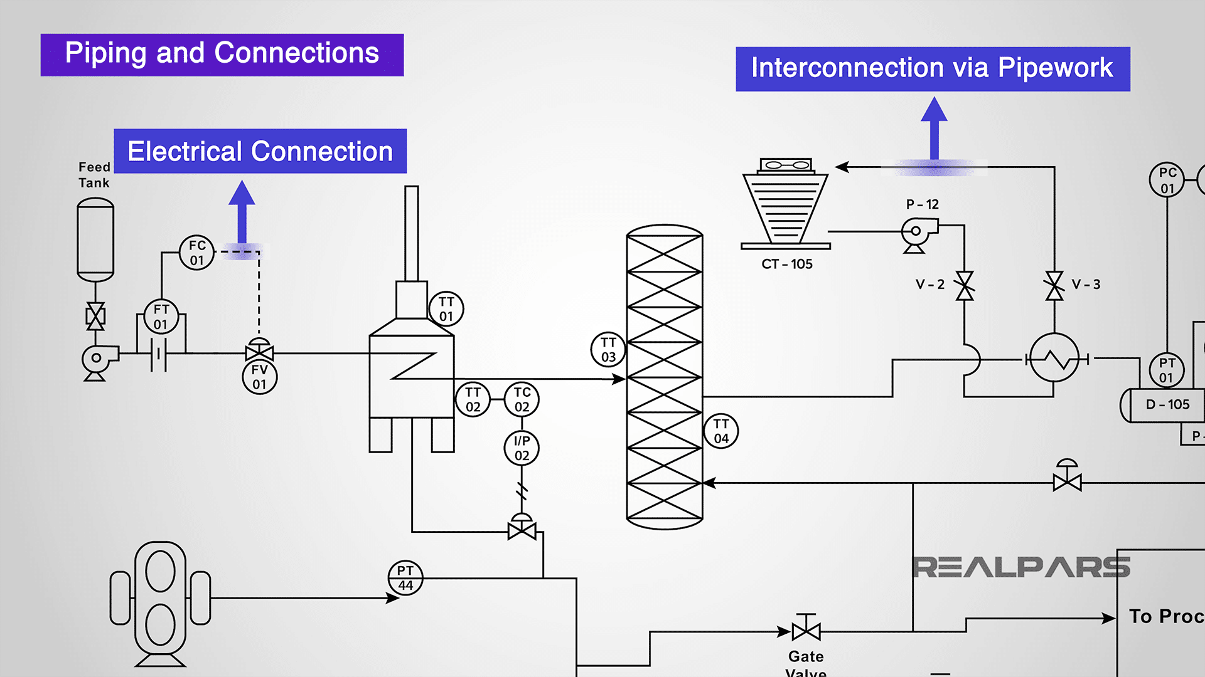
PIPING & INSTRUMENTATION DIAGRAM (P&ID)
How to read P&ID Symbols ?
https://www.realpars.com/blog/p-id
Source: Google Images
22-01-2025
15

Slide 16
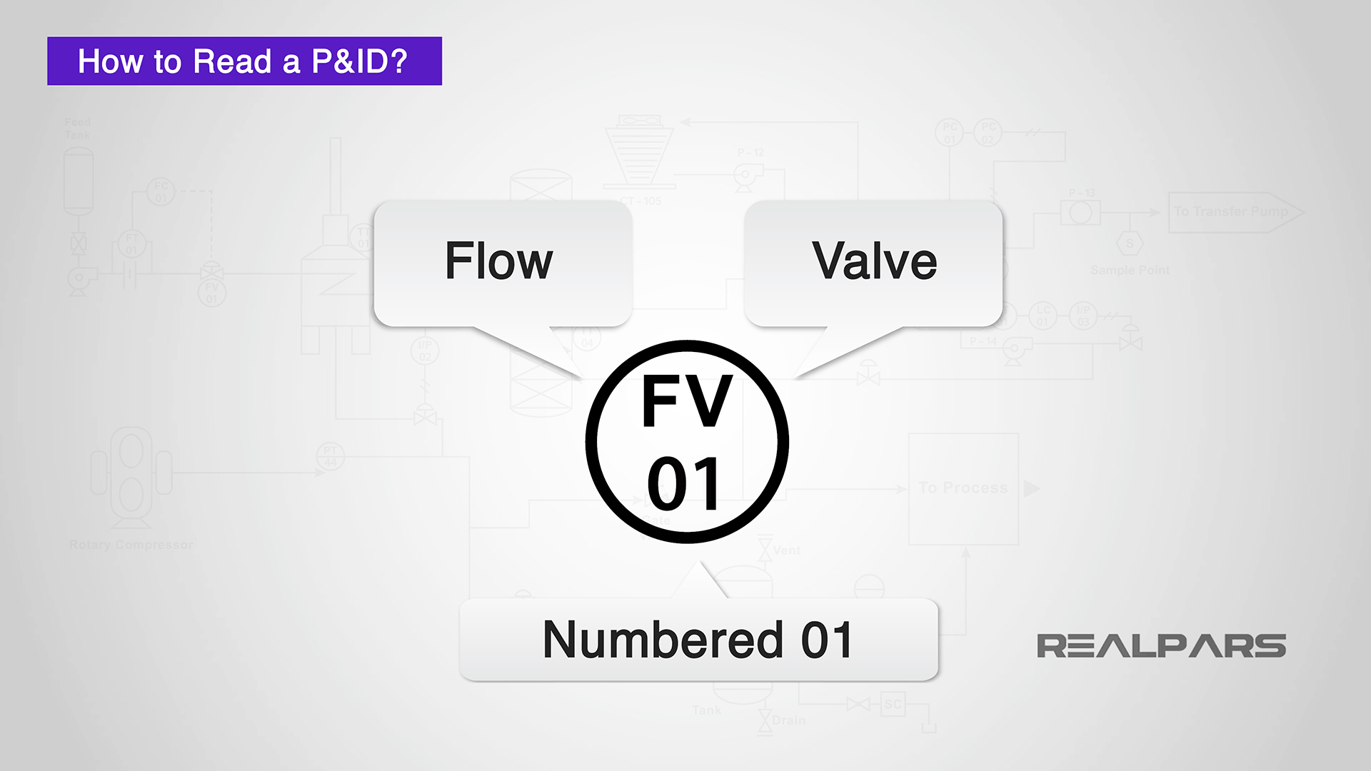
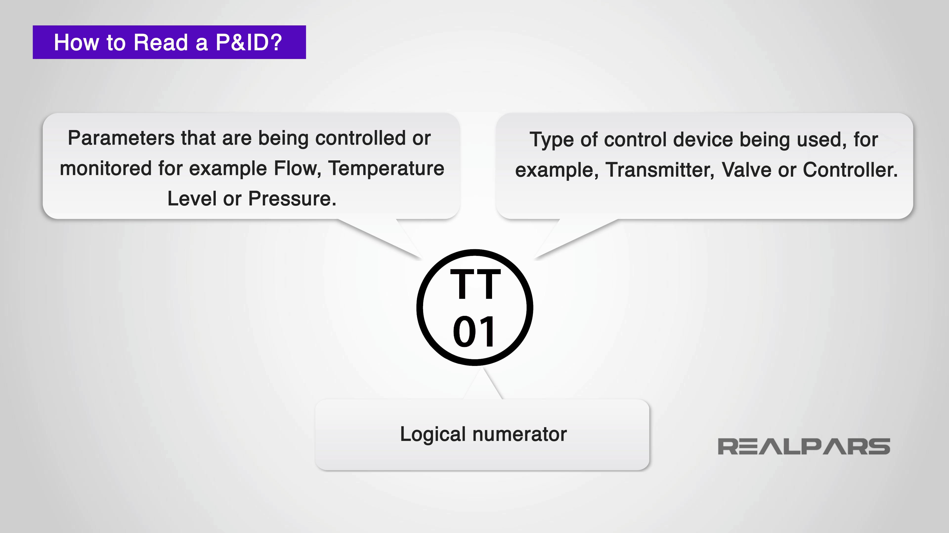
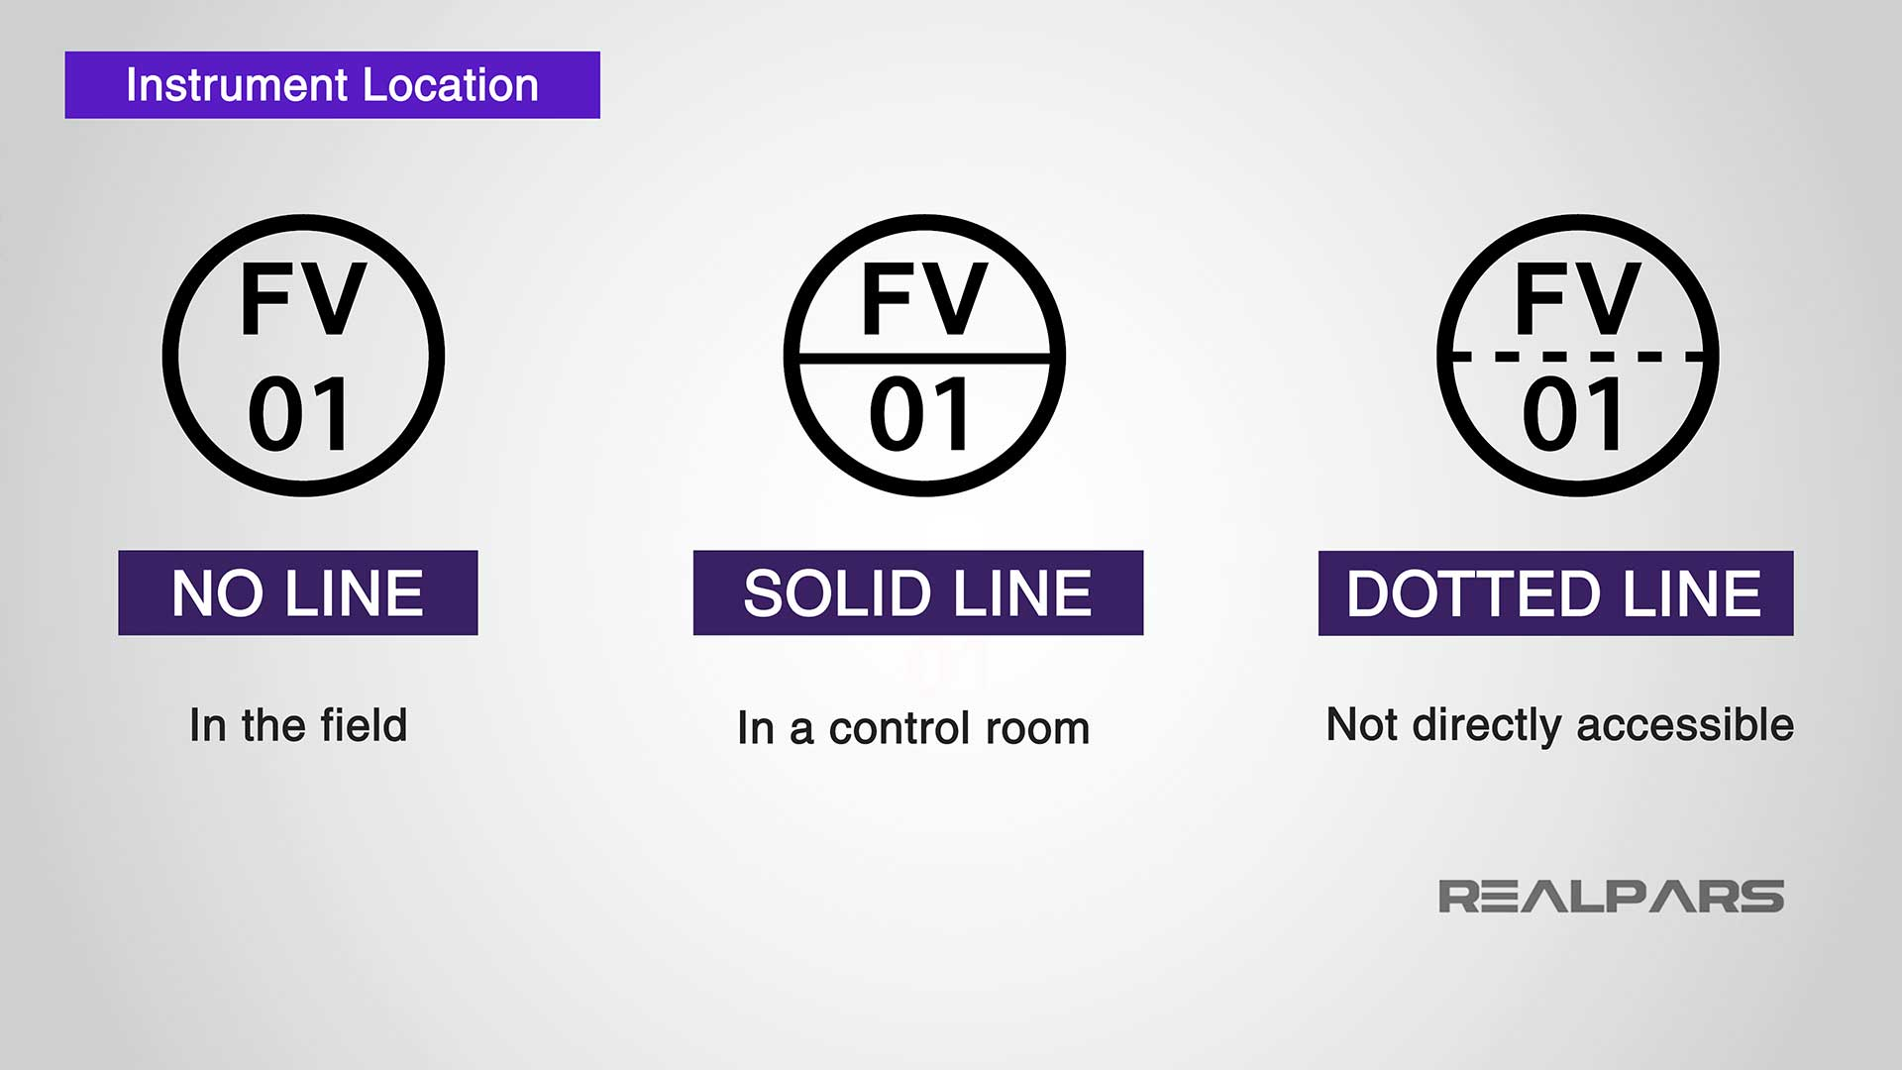
PIPING & INSTRUMENTATION DIAGRAM (P&ID)
How to read P&ID Symbols ?
https://www.realpars.com/blog/p-id
Source: Google Images
22-01-2025
16

Slide 17
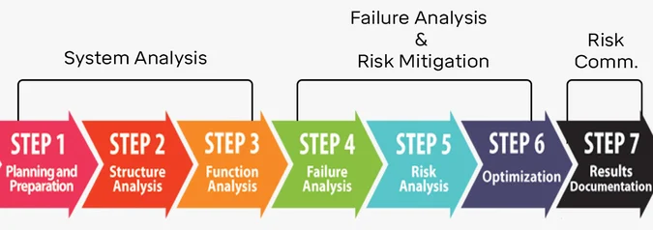
FAILURE MODES AND EFFECTS ANALYSIS (FMEA)
FMEA is a systematic, step-by-step approach for identifying all possible failures in a design, a manufacturing or assembly process, or a product or service.
It’s a risk assessment tool that helps to anticipate what might go wrong (failure mode), its impact (effects analysis), and how to prevent it by addressing the issues proactively.
FMEA is a living document that:
Catalogs all possible failures in products and processes.
Actively reduces the risks associated with these potential failures by implementing corrective measures.
Chronicles findings and lessons learned to bolster the success of current and future projects.
Source: Google Images
22-01-2025
17

Slide 18
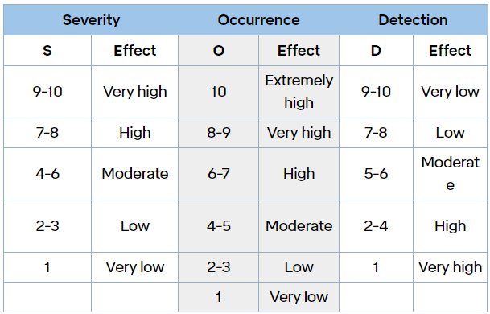
FAILURE MODES AND EFFECTS ANALYSIS (FMEA)
Process steps in FMEA:
Step 1: Identify potential failures and effects
Step 2: Determine severity
Step 3: Gauge likelihood of occurrence
Step 4: Failure detection
Step 5: Risk priority number (RPN)
Step 1: Identify potential failures and effects
Analyze functional requirements and their effects to identify all failure modes.
Examples: warping, electrical short circuit, oxidation, fracture.
Failure modes in one component can induce them in others.
List all failure modes per function in technical terms, considering the ultimate effect(s) of each failure mode and noting the failure effect(s).
Examples: overheating, noise, abnormal shutdown, user injury.
Step 2 – 4: Determine severity, occurrence, detection
Source: Google Images
22-01-2025
18

Slide 19

FAILURE MODES AND EFFECTS ANALYSIS (FMEA)
Risk priority number (RPN)
After the foregoing basic steps, risk assessors calculate Risk Priority Numbers (RPNs). These influence the choice of action against failure modes. RPN is calculated from the values of S, O and D as follows:
RPN should be calculated for the entire design and/or process and documented in the FMEA.
Results should reveal the most problematic areas, and the highest RPNs should get highest priority for corrective measures.
These measures can include a variety of actions: new inspections, tests or procedures, design changes, different components, added redundancy, modified limits, etc. Goals of corrective measures include, in order of desirability:
Eliminate failure modes (some are more preventable than others)
Minimize the severity of failure modes
Reduce the occurrence of failure modes
Improve detection of failure modes
When corrective measures are implemented, RPN is calculated again and the results documented in the FMEA.
RPN = S × O × D
RPN of more than 300 is considered unsafe
22-01-2025
19

Slide 20
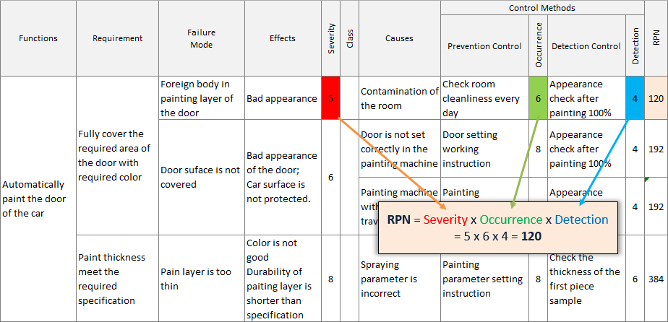
FAILURE MODES AND EFFECTS ANALYSIS (FMEA)
Risk Priority Number (RPN) Example
Source: Google Images
22-01-2025
20

Slide 21
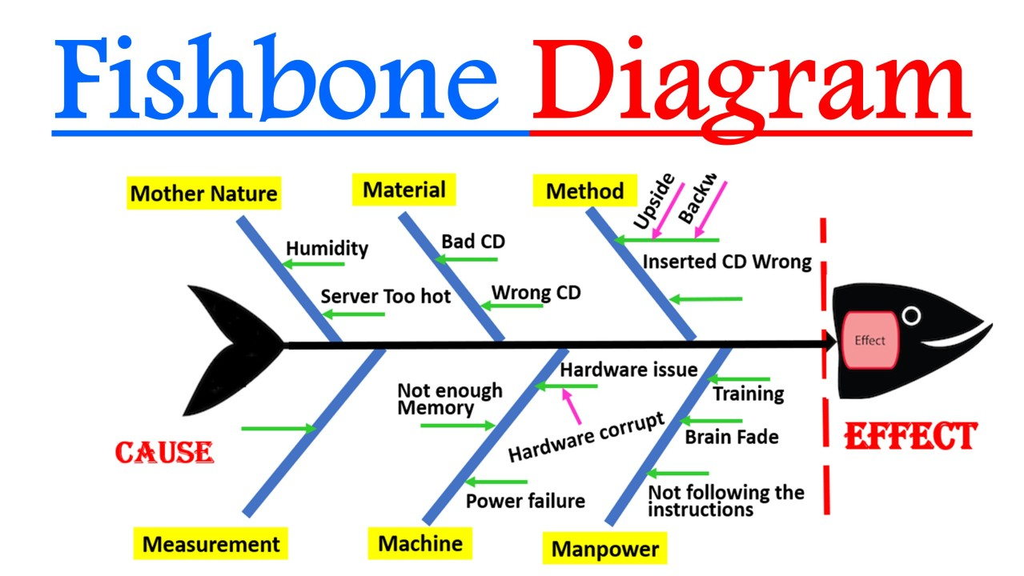
ROOT-CAUSE ANALYSIS (RCA)
ISHIKAWA DIAGRAM
Quality management process used in the Kawasaki shipyards.
The basic concept was first used in the 1920s, and is considered one of the seven basic tools of quality control.
Mazda Motors famously used an Ishikawa diagram in the development of the Miata (MX5) sports car.
Kaoru Ishikawa
Popularized in the 1960s
Source: Google Images
22-01-2025
21

Slide 22
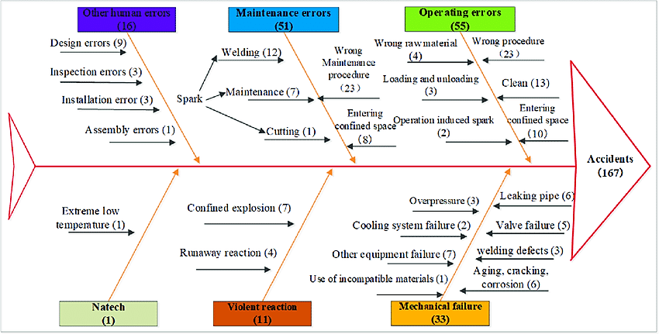
ROOT-CAUSE ANALYSIS (RCA)
Other Human Errors (16)
Maintenance Errors (51)
Operation Errors
(55)
Mother Nature
Environmental (1)
Violent Reaction
(11)
Mechanical Failures
(33)
ISHIKAWA DIAGRAM
Source: Google Images
22-01-2025
22

Slide 23
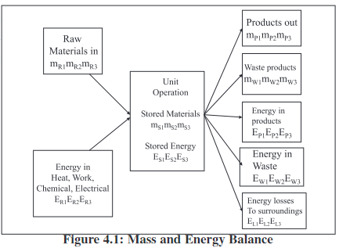
ENERGY & MATERIAL BALANACES (EMB)
Relevant to Chemical Process Calculations Course also
The law of conservation of mass leads to a mass or a material balance.
Mass In = Mass Out + Mass Stored
Raw Materials = Products + Wastes + Stored Materials.
= Total Raw Materials
= Total Products.
= Total Waste Products
= Total Stored Products.
Energy In = Energy Out + Energy Stored
= Total Energy of Raw Materials
= Total Energy Lost
= Total Energy of Products
= Total Energy Stored
= Total Energy of Wastes
Source: Google Images
22-01-2025
23

Slide 24
ENERGY & MATERIAL BALANACES (EMB)
Q. Skim milk is prepared by the removal of some of the fat from whole milk. This skim milk is found to contain 90.5% water, 3.5% protein, 5.1% carbohydrate, 0.1% fat and 0.8% ash. If the original milk contained 4.5% fat, calculate its composition assuming that fat only was removed to make the skim milk and that there are no losses in processing.
Basis: 100 kg of skim milk.
This contains, therefore, 0.1 kg of fat. Let the fat which was removed from it to make skim milk be x kg.
Total original fat = (x + 0.1)kg
Total original mass = (100 + x) kg
and as it is known that the original fat content was 4.5% so,
(x + 0.1) / (100 + x) = 0.045
where = x + 0.1 = 0.045(100 + x)
x = 4.6 kg
So, the composition of the whole milk is then fat = 4.5%, water = 90.5/104.6 = 86.5%, protein = 3.5/104.6 = 3.3%, carbohydrate= 5.1/104.6 = 4.9% and ash = 0.8%
22-01-2025
24

Slide 25
ENERGY & MATERIAL BALANACES (EMB)
ASSIGNMENT
Q1. If 35,000 kg of whole milk containing 4% fat is to be separated in a 6 hour period into skim milk with 0.45% fat and cream with 45% fat, what are the flow rates of the two output streams from a continuous centrifuge which accomplishes this separation? Basis: 1 hour's flow of whole milk.
Q2. An autoclave contains 1000 cans of pea soup. It is heated to an overall temperature of 100 °C. If the cans are to be cooled to 40 °C before leaving the autoclave, how much cooling water is required if it enters at 15 °C and leaves at 35 °C?
The specific heats of the pea soup and the can metal are respectively 4.1 kJ/ kg °C and 0.50 kJ/ kg °C. The weight of each can is 60g and it contains 0.45 kg of pea soup. Assume that the heat content of the autoclave walls above 40 °C is 1.6 × 10⁴ kJ and that there is no heat loss through the walls.
Q3. A fabric filter (bag filter) is used to remove the dust from the inlet gas stream so that outlet gas stream meets the required emission standards in cement, fertilizer and other chemical industries. During an air pollution monitoring study, the inlet gas stream to a bag filter is 1,69,920 m³/hr and the dust loading is 4577 mg/m³. The outlet gas stream from the bag filter is 1,85,040 m³/hr and the dust loading is 57 mg/m³. What is the maximum quantity of ash that will have to be removed per hour from the bag filter hopper based on these test results?
Submission: Next Class
22-01-2025
25

Slide 26
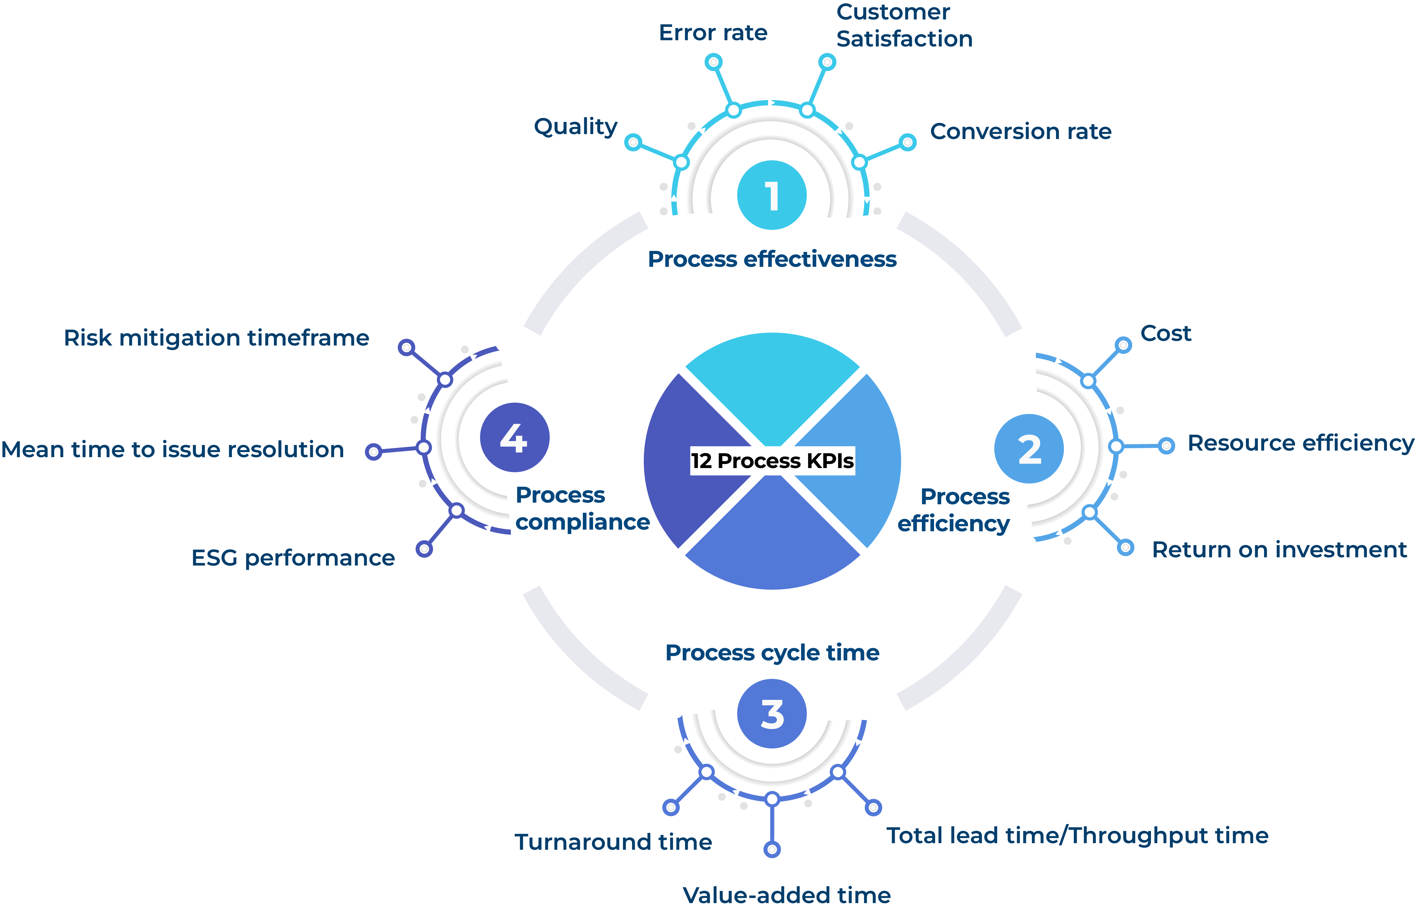
KEY PERFORMANCE INDICATOR (KPI)
KPI
Source: Google Images

Slide 27
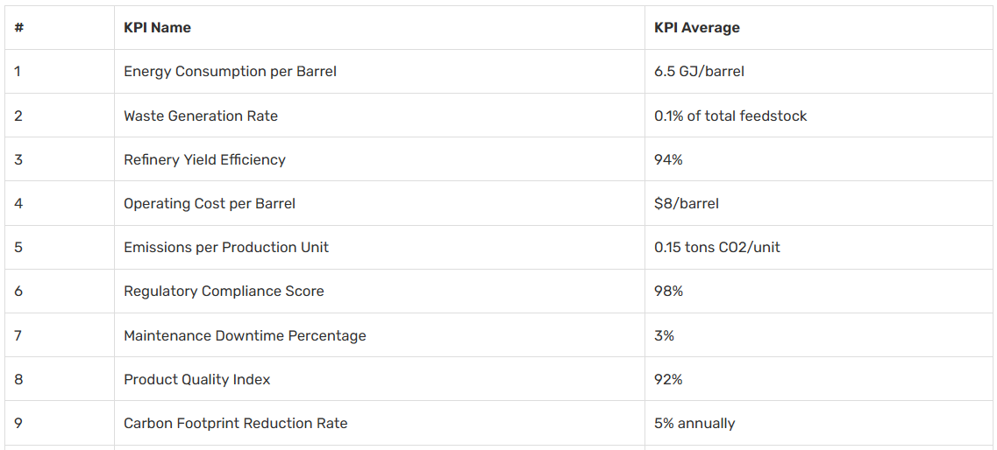
KEY PERFORMANCE INDICATOR (KPI)
Essential KPIs for Oil Refining and Processing
Source: Google Images

Slide 28
FAULT TREE ANALYSIS (FTA)
Method of identifying the possible causes of a system failure.
FTA is a type of failure analysis in which an undesired state of a system is examined.
This analysis method is mainly used in safety and reliability engineering to understand how systems can fail, to identify the best ways to reduce risk and to determine event rates of a safety accident or a particular system level (functional) failure.
FTA is used in the aerospace, nuclear power, chemical and process, pharmaceutical, petrochemical and other high-hazard industries.
ANNECDOTES
FTA: originally developed in 1962 at Bell Laboratories by H.A. Watson, under a U.S. Air Force Ballistics Systems Division contract to evaluate the Minuteman I Intercontinental Ballistic Missile (ICBM) Launch Control System.
Apollo program (NASA): Probability of successfully sending astronauts to the moon and returning them safely to Earth, which was unacceptably low. This result discouraged NASA from FTA/PRA and adopted only FMEA until after the Challenger accident in 1986.
After the Challenger accident, the importance of probabilistic risk assessment (PRA) and FTA in systems risk and reliability analysis was realized.
Now, FTA: Most important system reliability and safety analysis techniques.

Slide 29
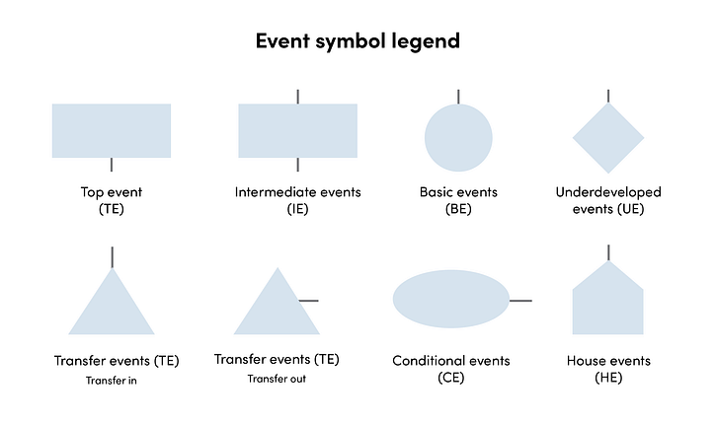
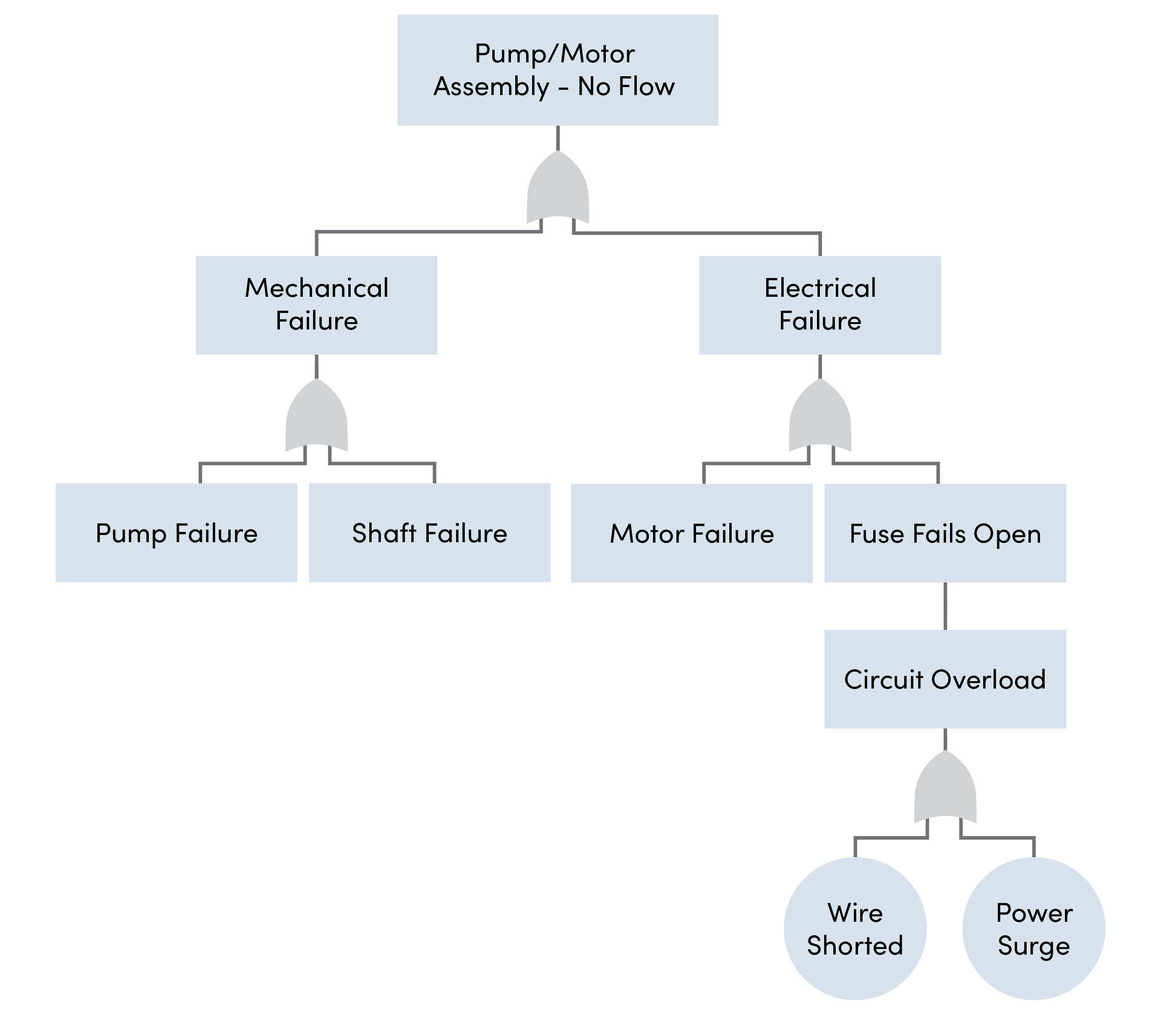
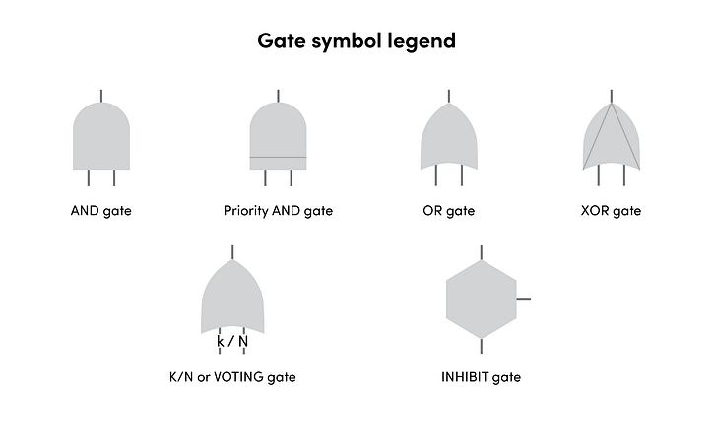
FAULT TREE ANALYSIS (FTA)
Boolean Algebra – Logic Gates
FTA: Illustration of a pump or motor assembly not having any flow
Source: Google Images

Slide 30













FAULT TREE ANALYSIS (FTA)
Example of FTA: Calculation of a process plant fire hazard
Plant Burns Down
Combustibles
Fire out of control
Ignition
Smoking
Short
Circuit
Sparks
There is a 1.98% chance that the plant is going to burn down.

Slide 31
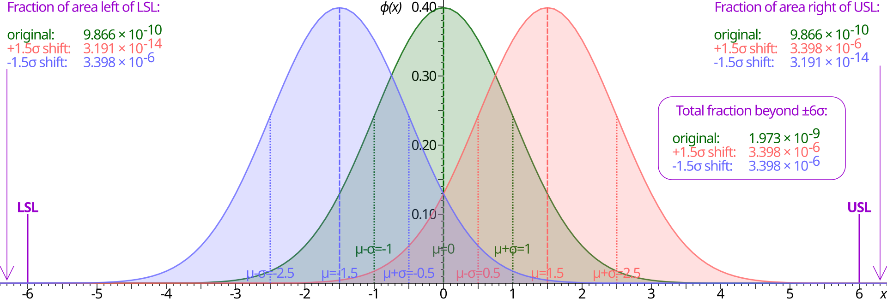
SIX SIGMA ANALYSIS (6σA)
Normal distribution underlies the statistical assumptions of Six Sigma.
At 0, μ (mu) marks the mean, with the horizontal axis showing distance from the mean, denoted in units of standard deviation (represented as σ or sigma).
The greater the standard deviation, the larger the spread of values; for the green curve, μ = 0 and σ = 1.
The upper and lower specification limits (USL and LSL) are at a distance of 6σ from the mean.
Normal distribution means that values far away from the mean are extremely unlikely—approximately 1 in a billion too low, and the same too high.
Even if the mean were to move right or left by 1.5 standard deviations (also known as a 1.5σ shift, colored red and blue), there is still a safety cushion.

Slide 32
SIX SIGMA ANALYSIS (6σA)
ANNECDOTES
Motorola pioneered Six Sigma, setting a "six sigma" goal for its manufacturing business.
In 2005 Motorola attributed over $17 billion in savings to Six Sigma.
Honeywell and General Electric were also early adopters of Six Sigma.
Processes that operate with "six sigma quality" over the short term are assumed to produce long-term defect levels below 3.4 defects per million opportunities (DPMO).

Slide 33
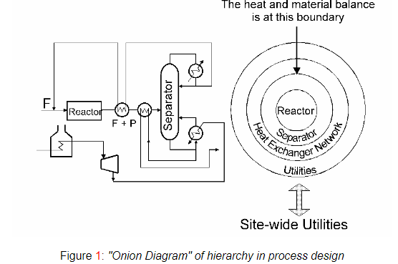
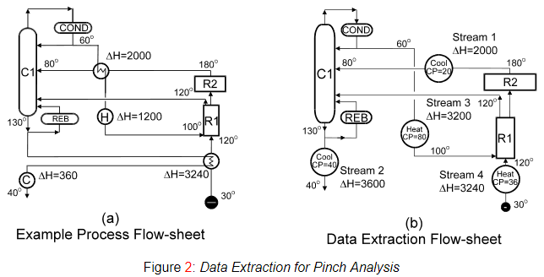
PROCESS OPTIMIZATION
Pinch Analysis is a powerful technique used in industrial processes to improve energy efficiency by optimizing heat recovery and reducing external energy demands.
Essentially, process optimization on the basis of thermodynamics of the process.
Hot utility demand: 1200 units (shown by H) Cold utility demand: 360 units (shown by C)
H
C
Feeds, products, recycle concentrations and flowrates are known, the separators (the second layer of the onion) can be designed.
The basic EMB is now in place, and the heat exchanger network (the third layer) can be designed.
The remaining heating and cooling duties are handled by the utility system (the fourth layer).
Extract the Thermal Data for Pinch Analysis.
The heat capacity flow rate (CP) is the mass flowrate (M) times the specific heat capacity (C_{p}) i.e. CP = C_{p} × M .
The CP of a stream is measured as enthalpy change per unit temperature (kW/ºC or equivalent units).

Slide 34
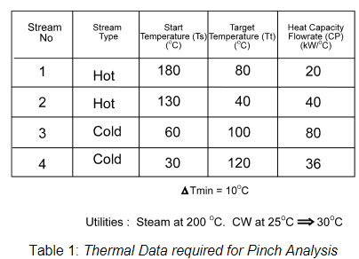
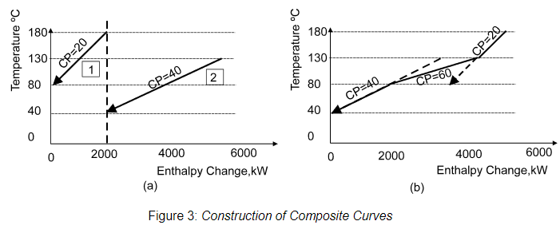
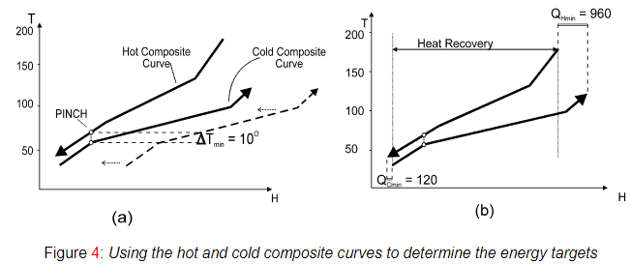




PINCH ANALYSIS
Pinch Analysis provides a target for the minimum energy consumption.
The energy targets are obtained using a tool called the “Composite Curves”.
Construction of Composite Curves
Hot Composite Curve
(HCC)
Cold Composite Curve (CCC)
HCC & CCC: separating them by the minimum temperature difference
Maximum process heat recovery possible
Remaining heating and cooling needs are the minimum hot utility requirement ( ) and the minimum cold utility requirement ( ) of the process for the chosen
Hot Composite Curve (HCC)

Slide 35
PINCH ANALYSIS
Sink
Source

Slide 36
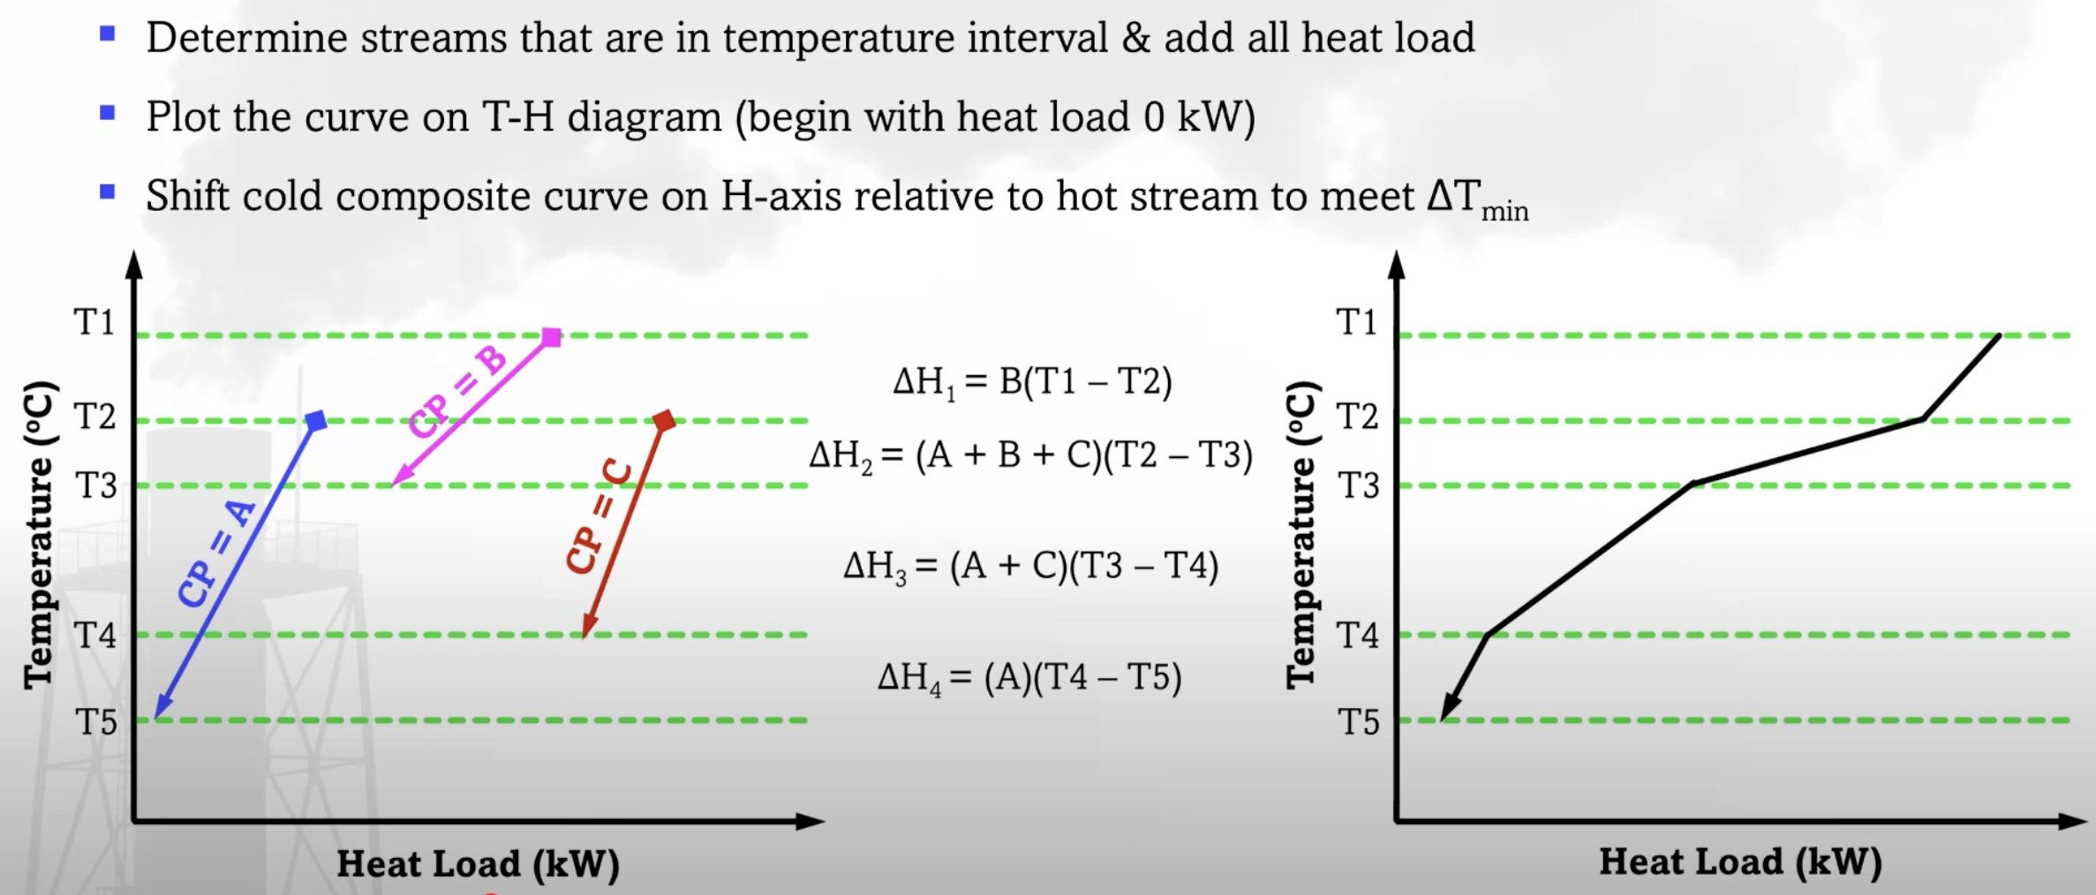
PINCH ANALYSIS
How to create HCC/CCC?

Slide 37
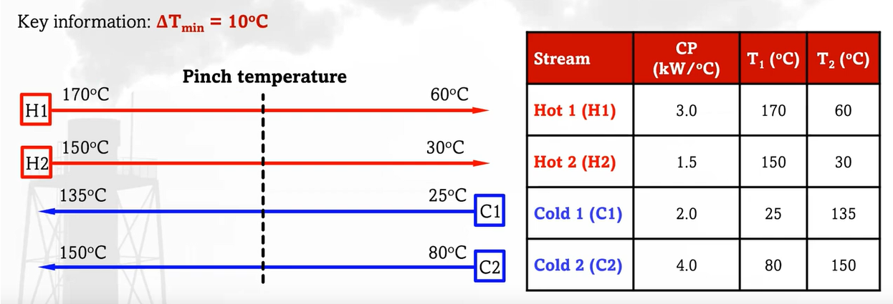
PINCH ANALYSIS
Assignment
Q1. Thermal data of 4 streams is shown below. Using key concept of pinch analysis, construct HCC and CCC to determine the pinch temperature, utility demand (hot and cold), and energy recovery.

Slide 38
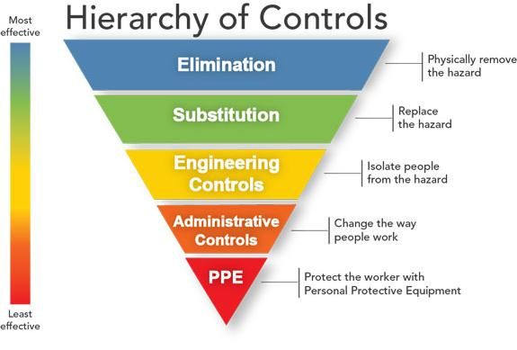
HAZARD IDENTIFICATION AND RISK ASSESSMENT (HIRA)
HIRA is an ongoing process in which safety specialists evaluate opportunities for the prevention and mitigation of accidental injuries and occupational illnesses.
Objectives of HIRA study:
Carryout a systematic, critical appraisal of all potential hazards involving personnel, plant, services and operation methods.
Identify the existing safeguards available to control the risks due to the hazards.
Suggest additional control measures to reduce the risk to acceptable level.
Prepare a Risk register that will help in continuously monitoring these risks, detect any changes and ensure the controls are effective.
Details of HIRA, HAZOP, HAZAN etc. will be discussed in the SAFETY Part !!!
Source: Google Images

